Slide 1
IBM University Engagement Project Submission
“Exploring the Power of Agentic AI with IBM Granite and IBM Bob”

Slide 2
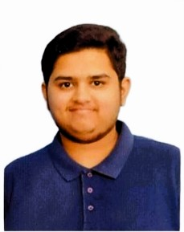
Project Tile – [MindCare AI – Agentic Mental Health Awareness & Suicide Prevention System ]
Domain of Project – [MindCare AI – Agentic Mental Health Awareness & Suicide Prevention System ]
Student Name | Recent Passport Photo | Email ID | Mobile number [WhatsApp]
B S PREETHAM BHARADWAJ |  | 254g1a47b0@srit.ac.in | 9110554125

Slide 3
Problem Statement -
The Challenge
Mental health issues such as depression, anxiety, and suicidal thoughts are growing worldwide. Stigma, lack of awareness, and limited access to timely help prevent many individuals from seeking support. Traditional systems are often reactive, leaving gaps in early detection and preventive care.
The Objective
Build an Agentic AI-powered Mental Health Awareness & Suicide Prevention Agent that is empathetic, proactive, and safe. The solution should:
1. Promote Awareness & Education – Share accessible resources on mindfulness, coping strategies, and self-care.
2. Enable Early Detection (RAG) – Use Retrieval-Augmented Generation to identify distress signals in conversations, journaling inputs, or safe online data.
3. Provide Empathetic Support – Build a conversational agent that listens actively and responds with empathy (with clear disclaimers: not a substitute for professional medical advice).
4. Predict & Prevent Risks – Forecast stress peaks, suggest preventive strategies, and issue alerts when high-risk signals are detected (with consent).
5. Connect to Human Support – Link users to helplines, counselors, or community support for timely intervention.
Tech Stack (Mandatory)
IBM Bob + IBM Cloud + IBM Granite

Slide 4
Proposed Solution -
MindCare AI – Mental Health Awareness & Suicide Prevention Agent
The proposed solution is a multi-agent AI-powered mental health support system built using IBM Bob, IBM Cloud, and IBM Granite Models to provide empathetic support, early distress detection, and preventive care.
At its core, the system uses Retrieval-Augmented Generation (RAG) to retrieve reliable mental health information from trusted sources such as WHO resources and verified helpline directories, enabling accurate, context-aware responses.
The solution consists of four key agents:
Awareness Agent: Provides mindfulness exercises, self-care tips, and mental health education.
Early Detection Agent: Analyses voluntary conversations and journal entries to identify potential emotional distress signals.
Empathetic Support Agent: Offers supportive conversations, coping strategies, and personalized recommendations without replacing professional medical advice.
Risk Prevention & Referral Agent: Identifies potential high-risk signals, recommends preventive actions, and connects users to verified helplines or professionals, with appropriate consent.
The solution includes a user-friendly dashboard to track mood patterns, access resources, and view personalized recommendations while protecting user privacy.
IBM Bob supports agent workflow development, IBM Cloud provides scalable deployment, and IBM Granite powers conversational AI and reasoning.
Overall, MindCare AI promotes mental well-being through early support, responsible AI, and timely human intervention.

Slide 5
Technology Used
IBM Bob Platform – For designing and orchestrating multi-agent workflows for mental health awareness, distress detection, and crisis support.
- IBM Granite Models – For natural language understanding, empathetic conversations, distress signal analysis, and personalized mental health recommendations.
- IBM Cloud – Provides a secure, reliable, and scalable infrastructure for deploying the MindCare AI platform.
- RAG (Retrieval-Augmented Generation) – Retrieves verified mental health information and helpline resources before generating context-aware responses.
- IBM watsonx.ai – For AI model deployment, embeddings, and AI governance.
- Vector Database (FAISS/Chroma) – For storing and retrieving mental health resources efficiently to support RAG-based responses.
- React / Streamlit – For building a user-friendly dashboard for mood tracking, journaling, and mental health resources.
- FastAPI / Flask – For connecting AI agents, managing API requests, and integrating backend services.

Slide 6
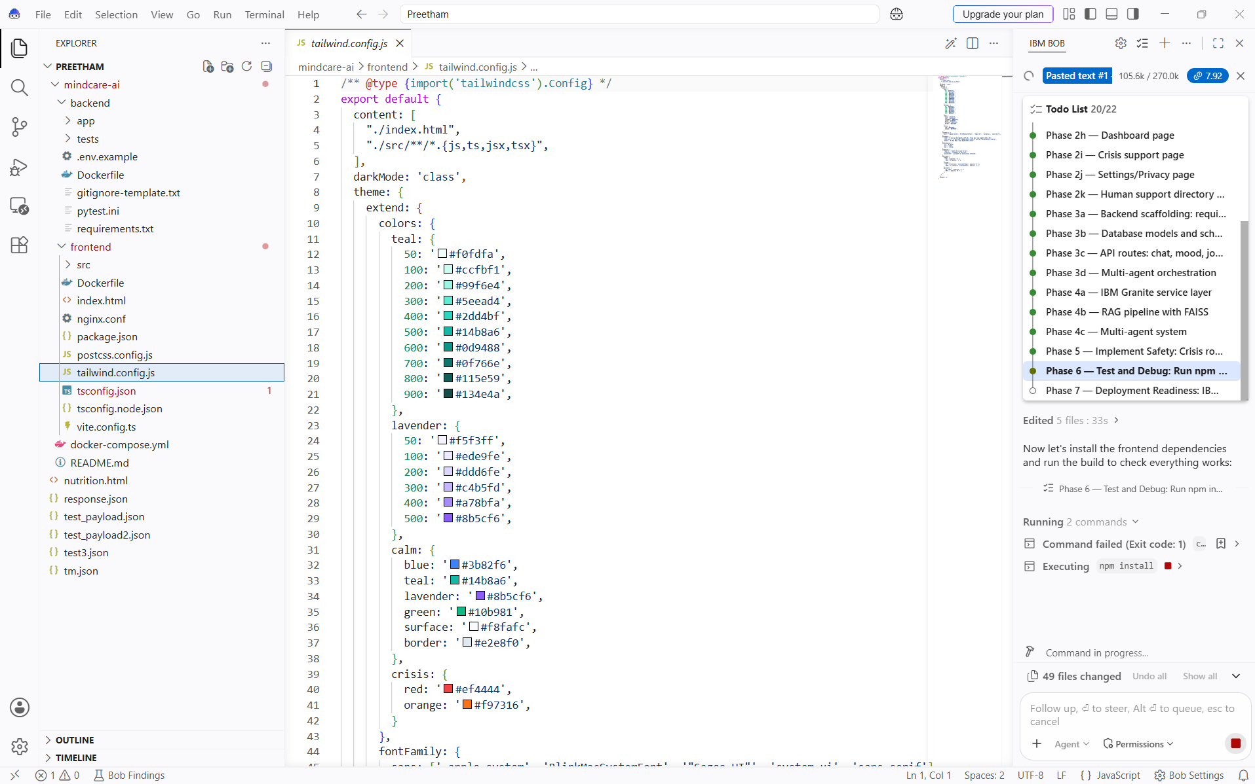
Required Files created using IBM bob -
App.py
Requirements.txt
Style.css
.env
Index.html

Slide 7
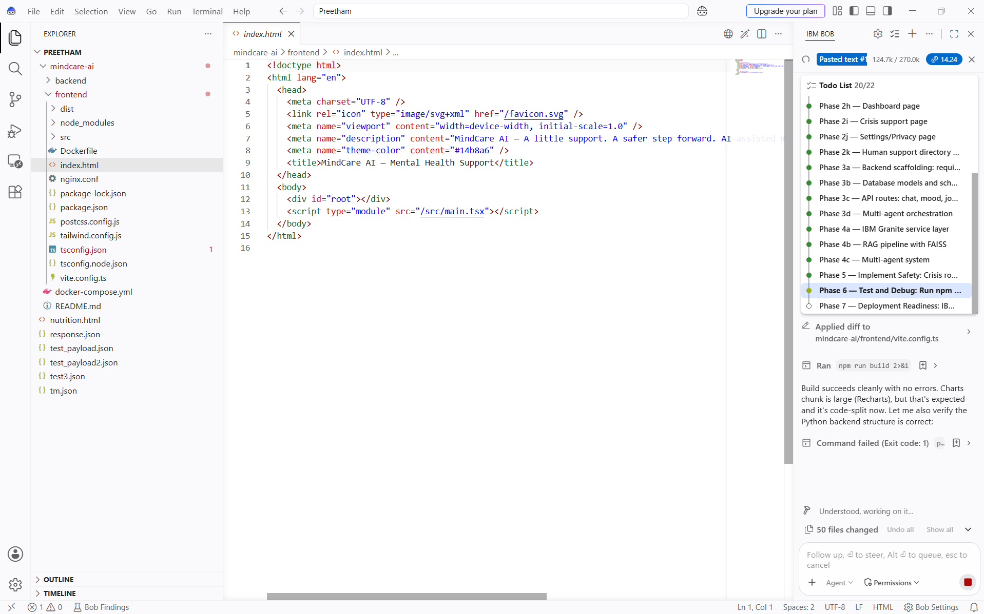
IBM Bob Screenshots:

Slide 8
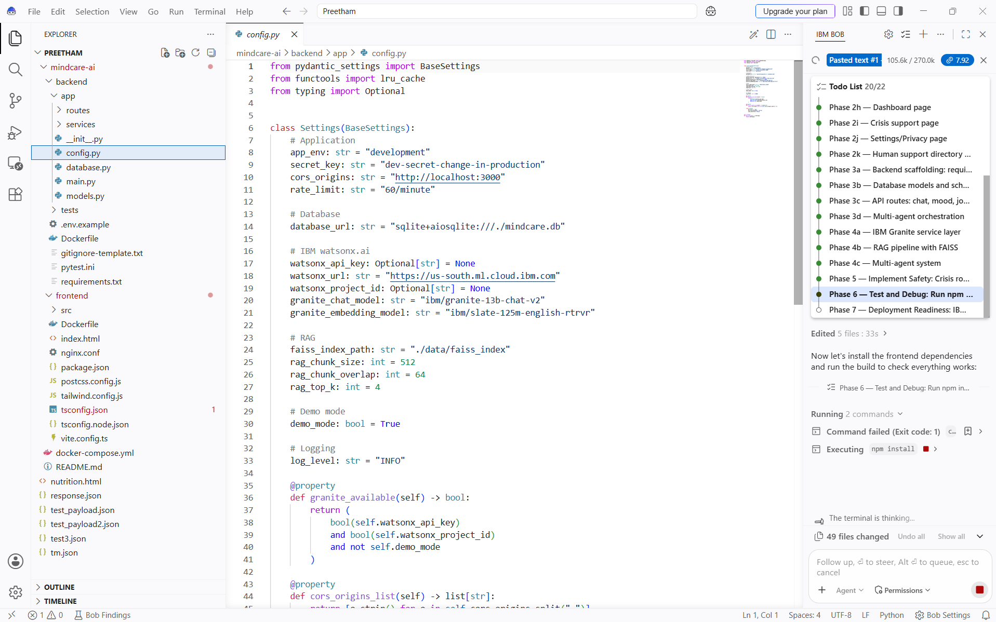

Slide 9
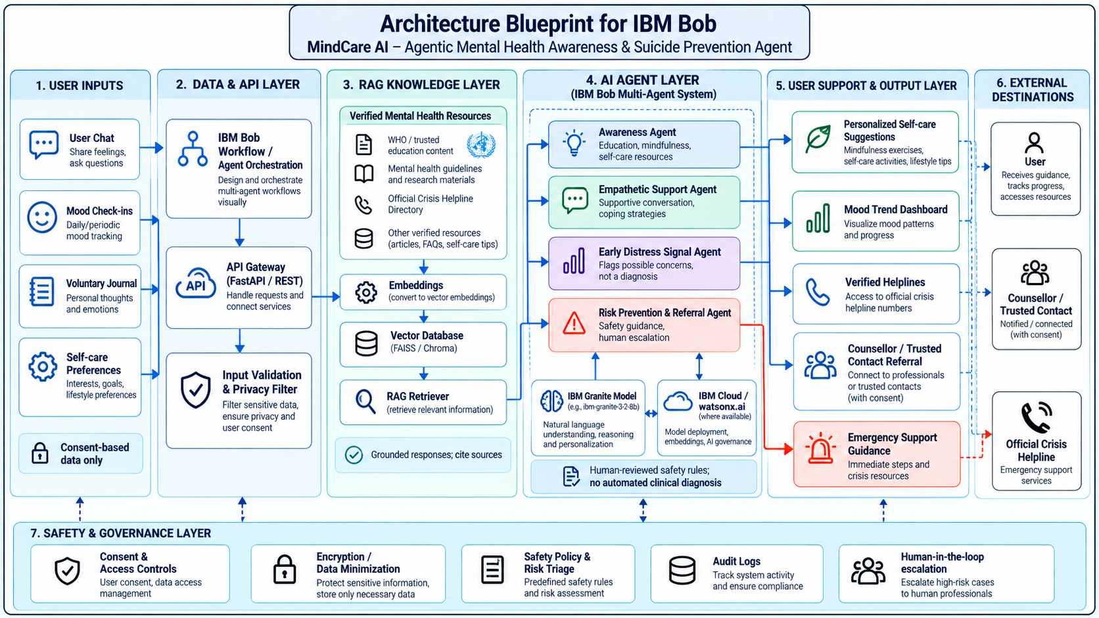
Architecture blueprint for IBM bob:

Slide 10
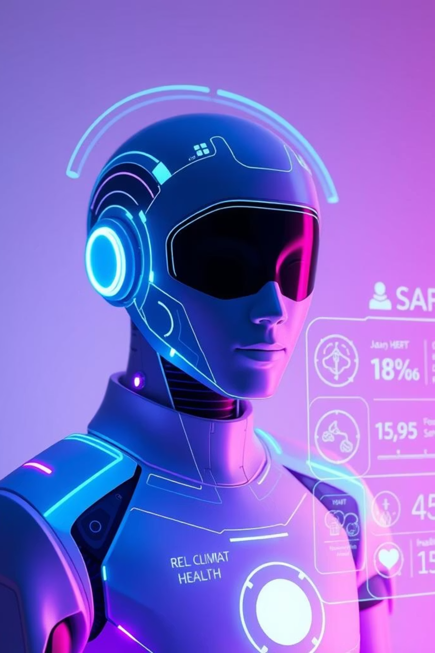
Role of Agentic AI in the Solution
Role of Agentic AI in Nutrition Agent
Agentic AI enables the Nutrition Agent to function as an intelligent, autonomous system rather than a simple chatbot. Using IBM watsonx.ai and IBM Granite models, it coordinates multiple specialized agents to deliver personalized nutrition guidance.
Each agent performs a specific role—such as retrieving nutritional data, generating diet plans, providing health advice, and analyzing food logs—while working collaboratively. This multi-agent approach ensures efficient task execution and accurate results.
Agentic AI also brings context awareness, understanding user details like age, health conditions, and fitness goals to generate tailored recommendations. It supports real-time adaptation, continuously updating suggestions based on user inputs like daily meals.
Additionally, agents communicate with each other, enabling better decision-making and improved outcomes.
Overall, Agentic AI makes the system proactive, personalized, and goal-driven, acting like a smart digital nutritionist that helps users maintain a healthy lifestyle.

Slide 11
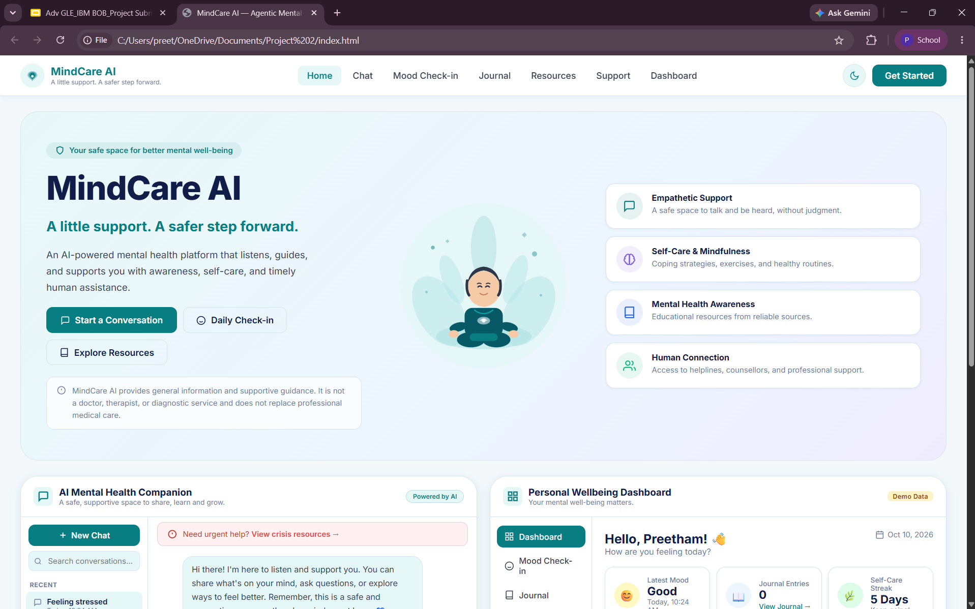
Project Output Screenshot
·
·
·

Slide 12
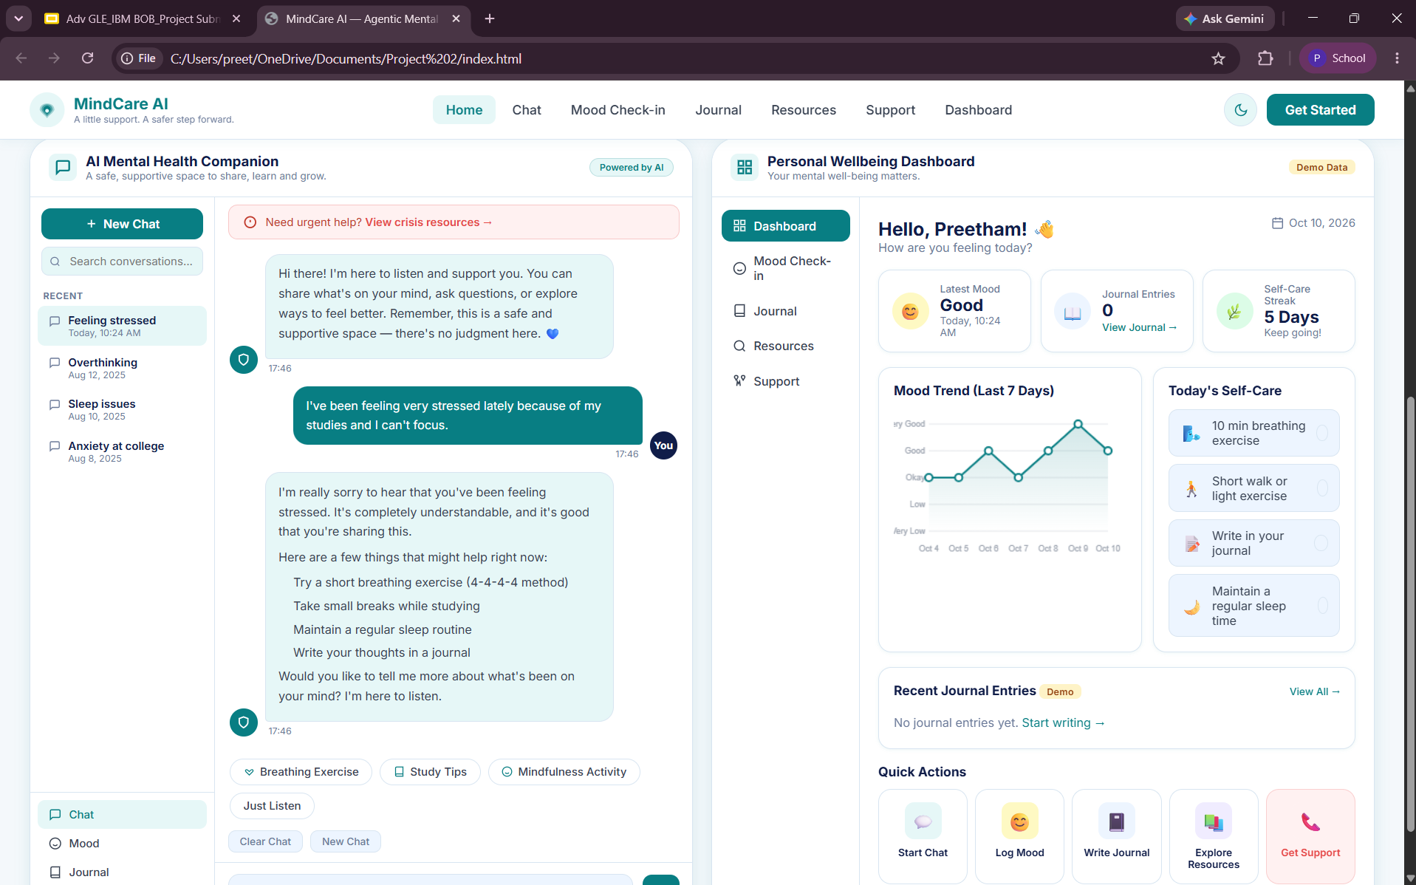
Project Output Screenshot
·
·
·

Slide 13
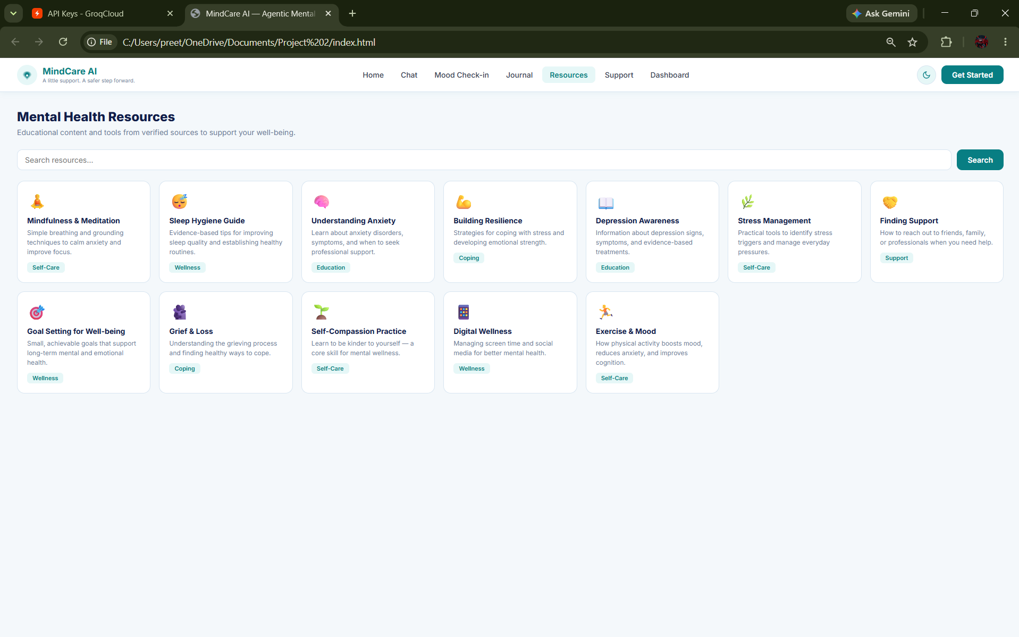
Project Output Screenshot
·
·
·

Slide 14
Novelty and Uniqueness
MindCare AI stands out by combining Agentic AI, RAG, and personalized mental health support into a single intelligent system.
Multi-Agent Intelligence – Multiple specialized agents collaborate to provide mental health education, emotional support, and risk prevention.
RAG-Based Reliability – Retrieves verified mental health resources and helpline information to generate trustworthy, context-aware responses.
Personalized Support – Adapts coping strategies and self-care recommendations to users’ concerns, preferences, and needs.
Early Distress Detection – Analyses voluntary journal entries and conversations to identify potential emotional distress signals without making clinical diagnoses.
Proactive Risk Prevention – Recognizes potential high-risk signals and prioritizes safety guidance and timely human intervention.
Human Support Integration – Connects users with verified helplines, counsellors, and trusted contacts with appropriate consent.
Privacy and Safety Focus – Uses consent-based data collection, privacy safeguards, and human oversight for sensitive situations.

Slide 15
Git Hub Link
· Please create public github repository (Enable Add README button while creating repository) with format –
Please test and Paste the working Github URL –
Make sure you have Uploaded following three files into your github repository
1) All Agent relevant files of IBM Cloud , 2) yourproblemstatement.pdf file 3) your projectpresntation.pptx file 4)any other files
·
·
·

Slide 16
Future Scope
1.Integration with Wearables & Health Devices –
The system can be integrated with smartwatches and fitness trackers to collect real-time data such as steps, calories burned, heart rate, and sleep patterns. This will enable the Nutrition Agent to provide more accurate and dynamic diet recommendations based on actual user activity and health metrics.
2.AI-Powered Voice Assistant & Multilingual Support –
Enhancing the system with a voice-enabled assistant and support for multiple languages will improve accessibility. Users can interact naturally in their preferred language, making the solution more inclusive and suitable for diverse populations, especially in regions with varied linguistic backgrounds.
·
·
·

Slide 17
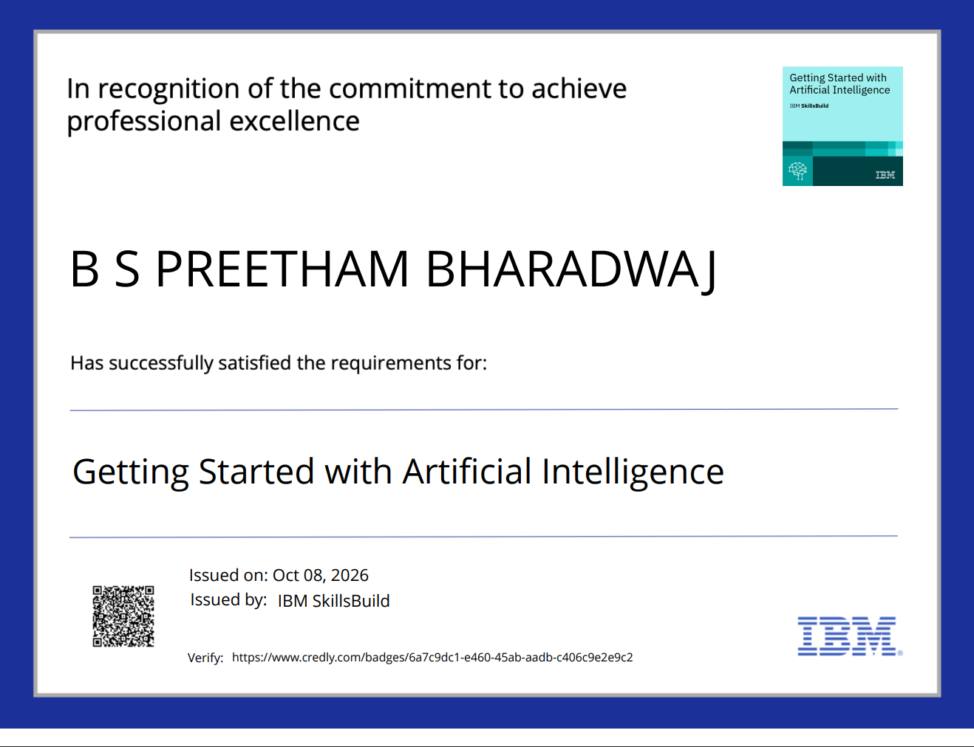
Certificates Earned:

Slide 18
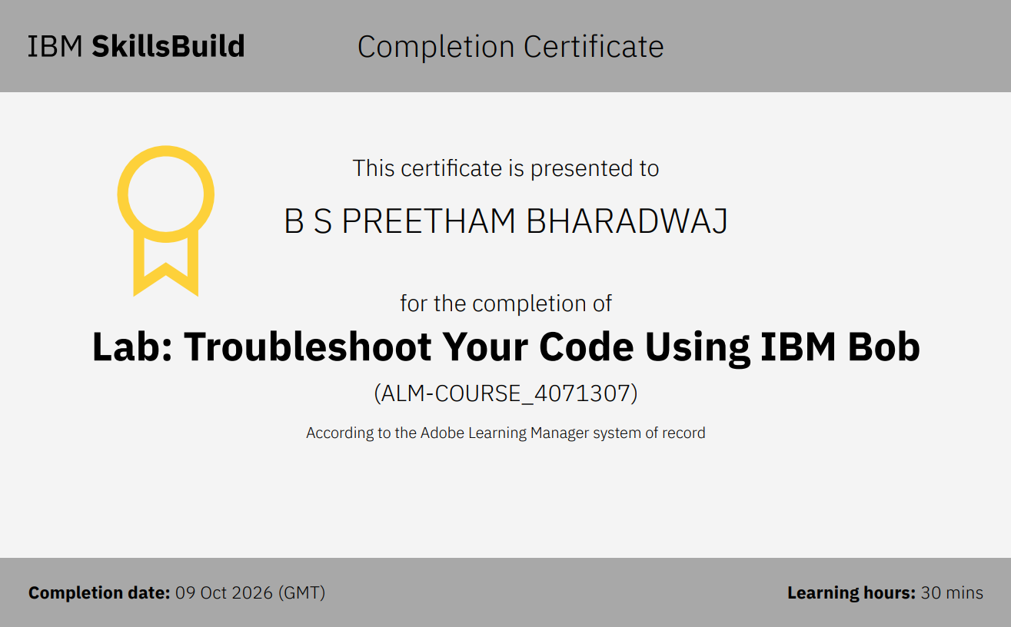
Certificates Earned:​

Slide 19


